Slide 1

IBM Client Engineering
Cloud Native Bootcamp
Tekton Pipelines
April/May 2022

Slide 2
Have you already used a CI/CD tool before ?

Slide 3
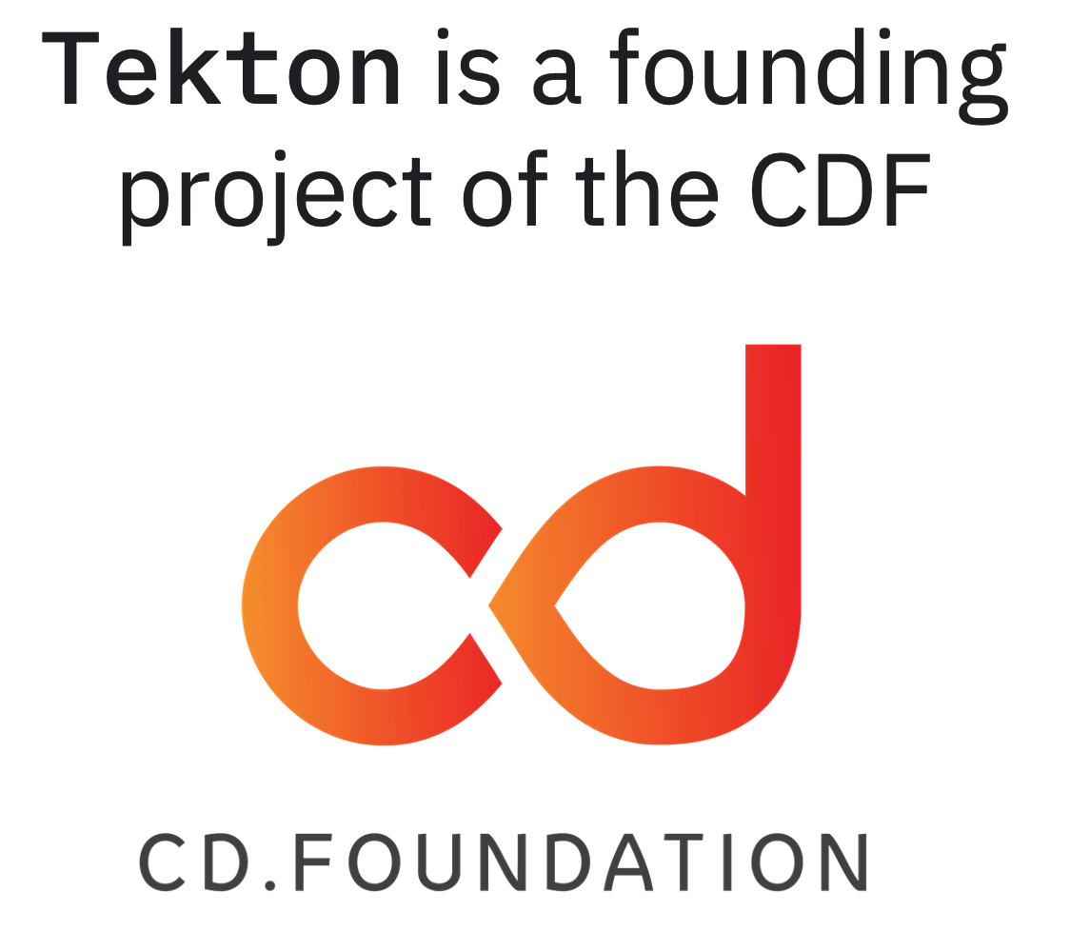
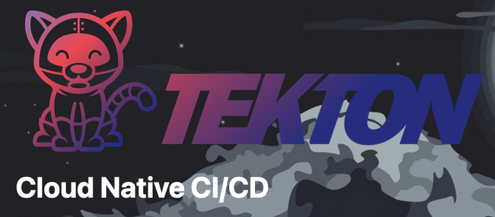
What is Tekton?
Kubernetes-native open-source framework for creating continuous integration and delivery (CI/CD) systems
Donated to the CDF
Group effort, with contributors from more than 150 companies!

Slide 4
What concepts does Tekton introduce?

Slide 5
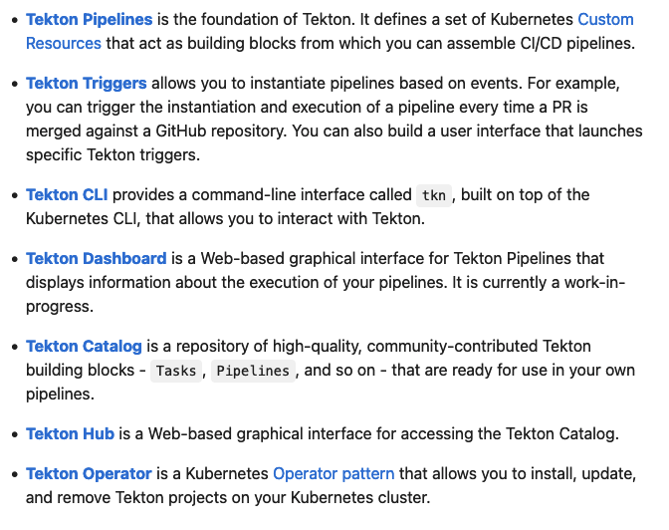

Tekton concepts

Slide 6
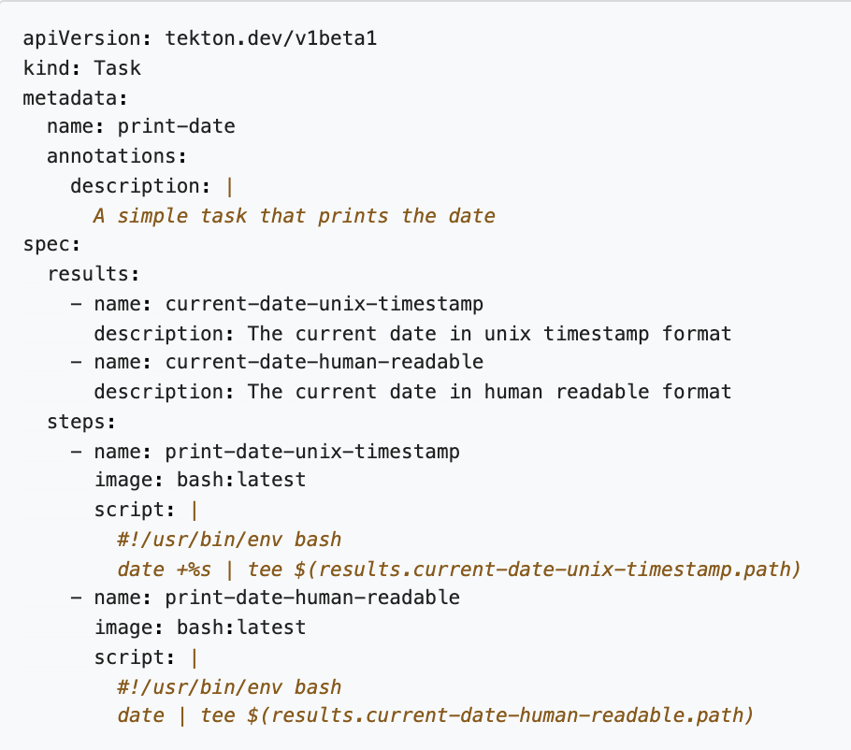
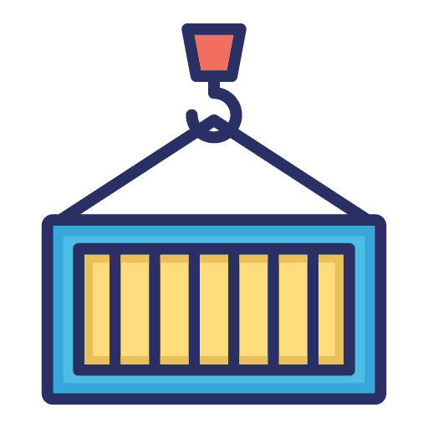
Step
Step
Container
Notes:
The first is a Step which is equivalent to a container image in which it executes a tool on the specified input parameters and produces an output.
Now, we can name the step to signify or identify what the step is doing.
And, specify the container image we want to pull.
Define the environment which is accessible to the container.
The script which is invoked as if it was stored inside the container image.

Slide 7
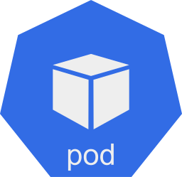
Task
Tekton Internal Workspace
/workspace
sequence of steps
Task
Pod

Slide 8
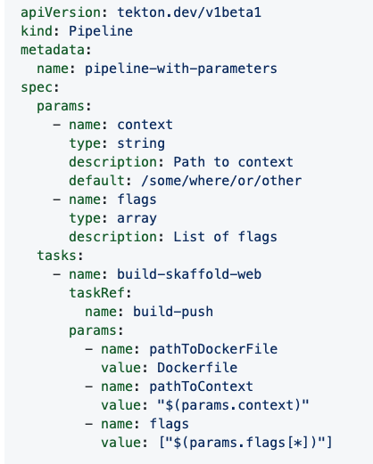
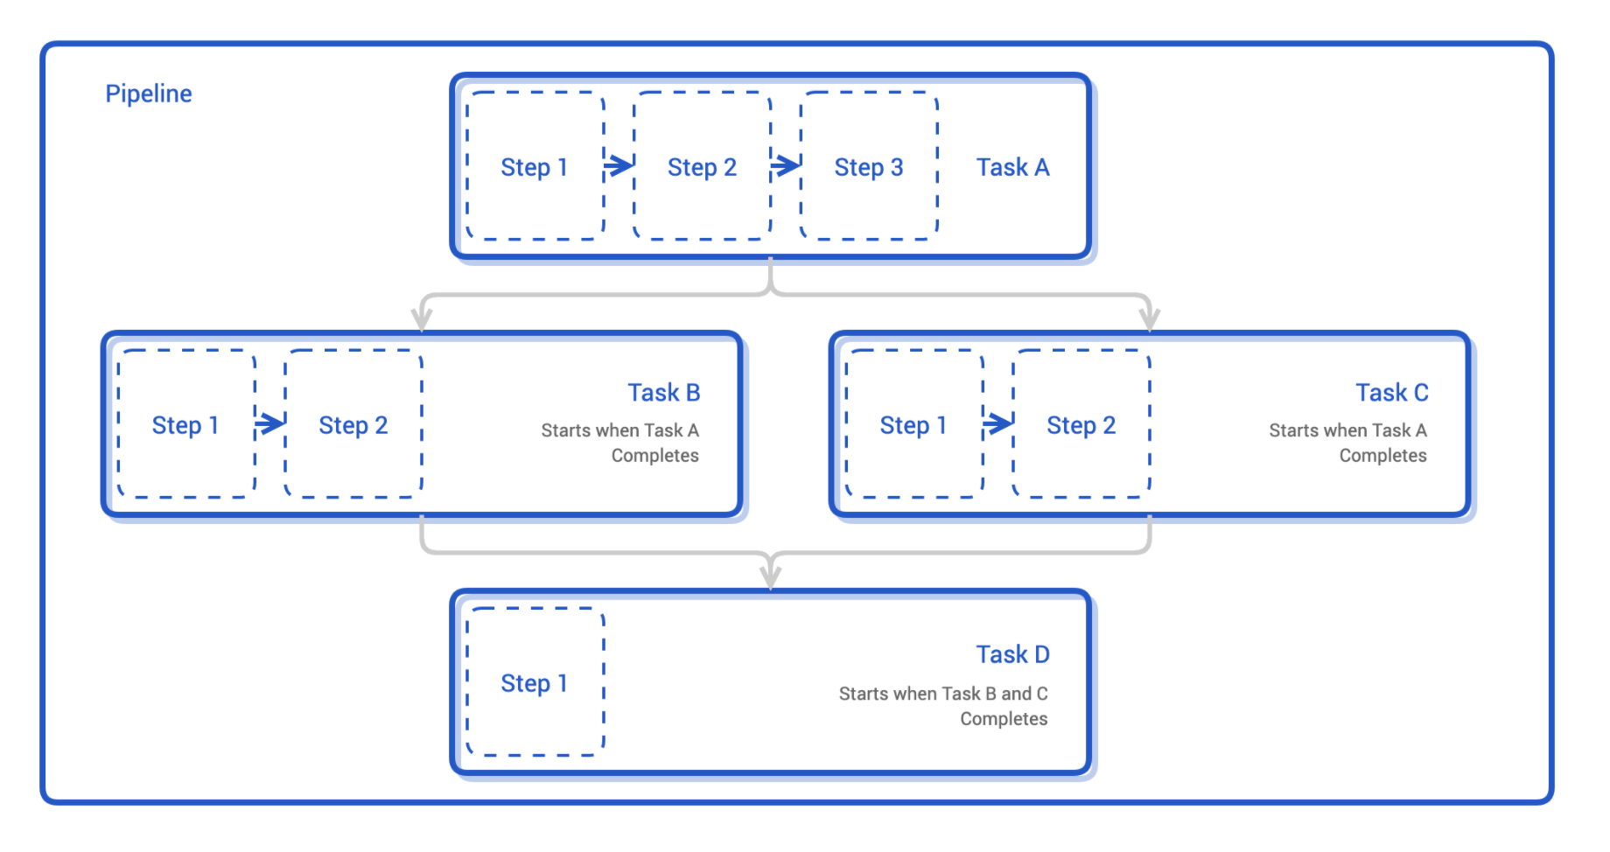
Pipeline
Notes:
The third is a pipeline which is a collection of tasks running a set of pods. A pipeline is a graph which provides the flexibility to organize the workflow based on the requirements. A pipeline combines tasks through parameters, results, and workspace. And also provides a step/task level isolation if needed.
Pipeline is a custom resource of kind Pipeline, and just like Task, we name the pipeline for future reference.
Pipeline specifications include a list of parameters and tasks.
For example, include a git-clone followed by build and in the end deploy the built application.
Each task and pipeline may have its own inputs and outputs, known as input and output resources in Tekton. A compilation task, for example, may have a git repository as input and a container image as output: the task clones the source code from the repository, runs some tests, and at last builds the source code into an executable container image.

Slide 9
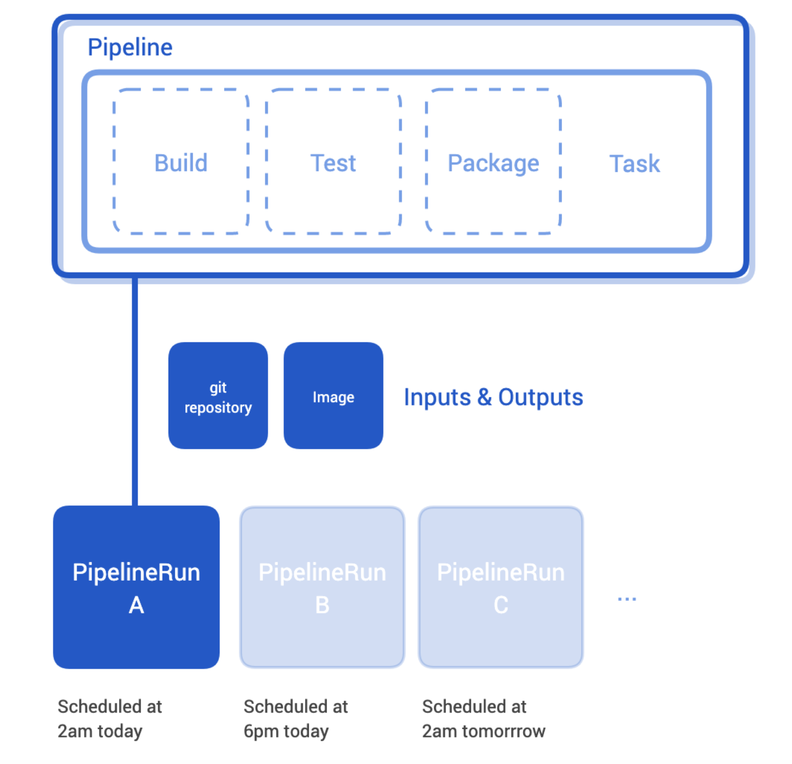
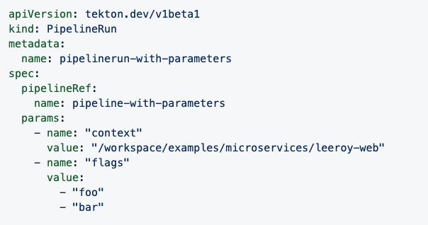
PipelineRun
Notes:
TaskRuns and pipelineRuns connect resources with tasks and pipelines. A run must include the actual addresses of resources, such as the URLs of repositories, its task or pipeline needs. This design allows developers to reuse tasks and pipelines for different inputs and outputs.

Slide 10
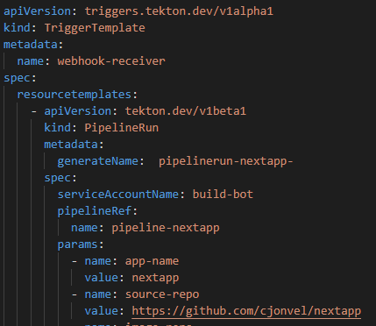
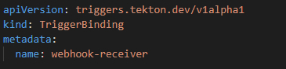
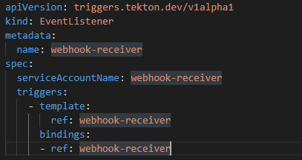
Trigger
Event listener
Pod
event
Trigger binding
Trigger Template
PipelineRun
e.g.: git pull
git push

Slide 11
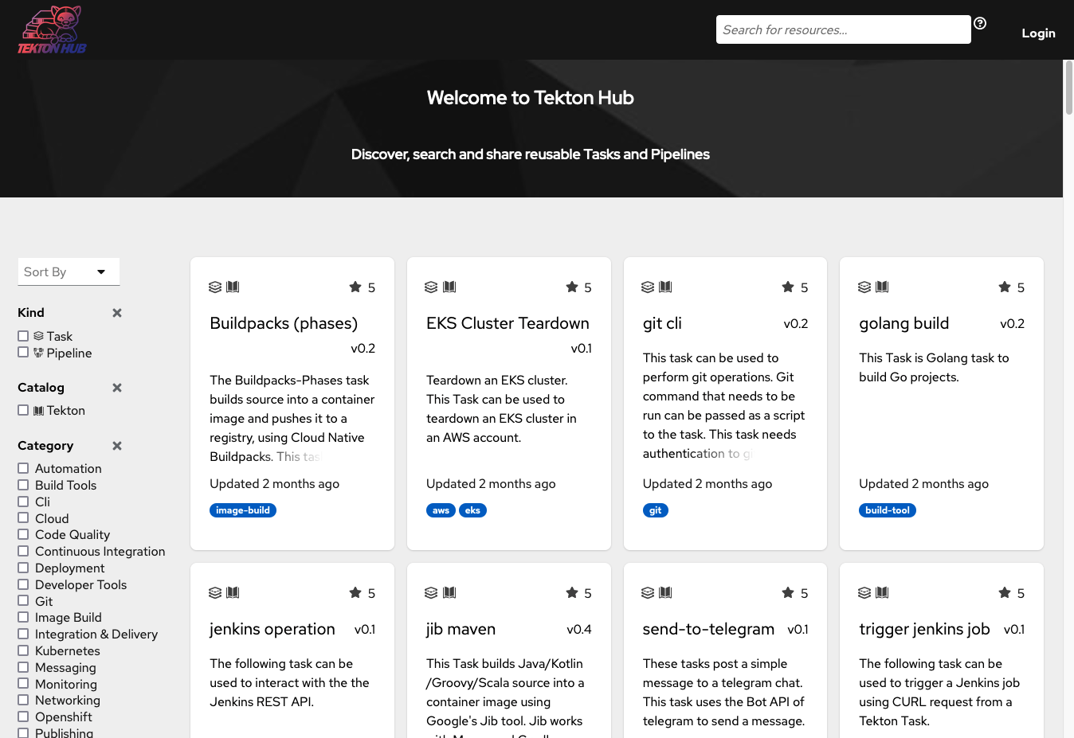
Catalog & Hub
https://hub.tekton.dev

Slide 12
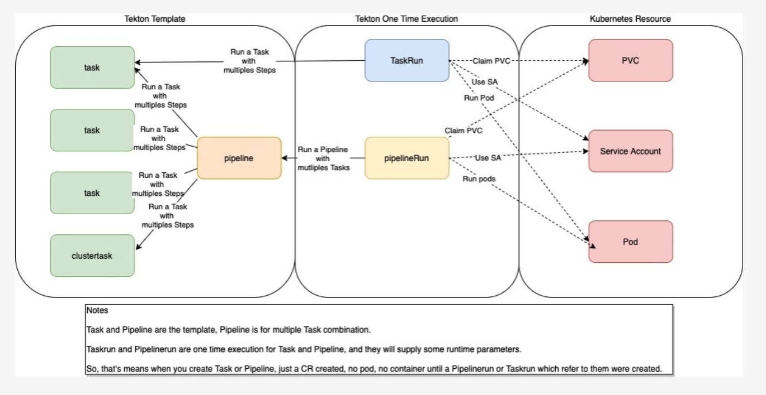
All in action!

Slide 13
Let’s start on an example!

Slide 14

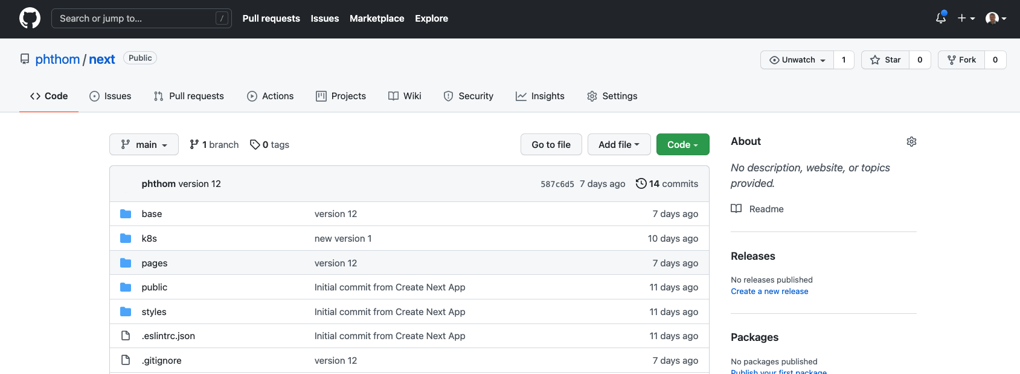
Assignment example

Slide 15
What is needed to deploy our code in the context of this lab? - infrastructure? - inputs? - minimum tasks for Node.js app? - outputs?

Slide 16
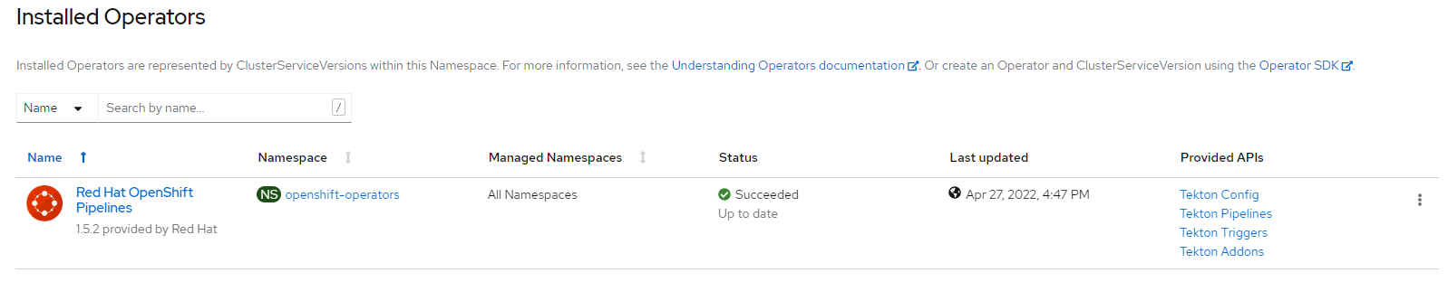
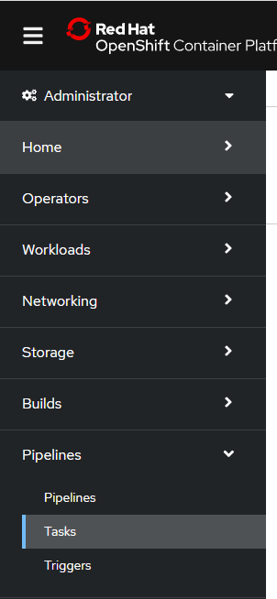
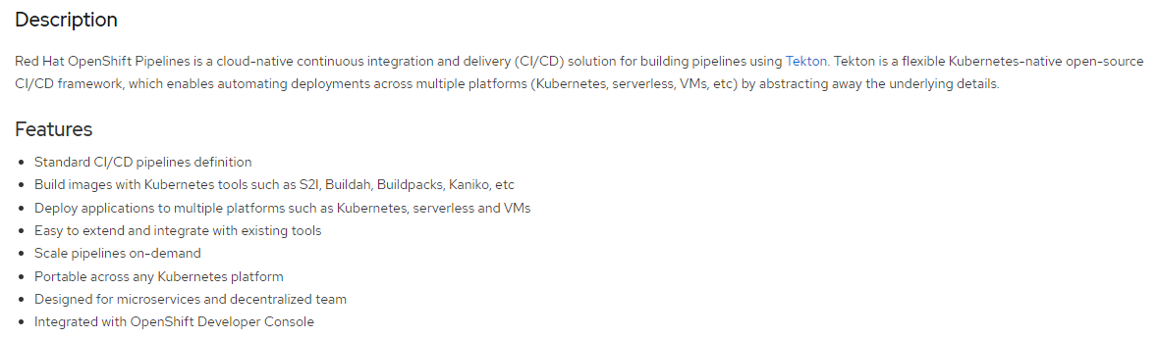
Infrastructure: OpenShift Pipelines Operator
Download tkn CLI from the link in the OCP Command Line Tools pane

Slide 17

Action chain
Input
Assignment scope
Push
Git Repo
Clone
Run CI tests
Build
Push
Kubernetes
Manifests
Deploy
to Dev
Store
Manifests
Deploy
To Prod
Source
Code
Container
Registry
Manifests
Repo
Outputs

Slide 18
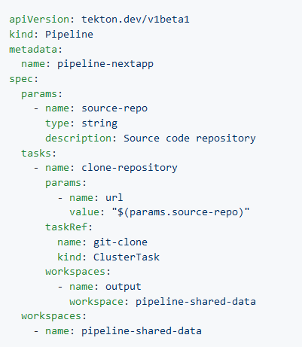
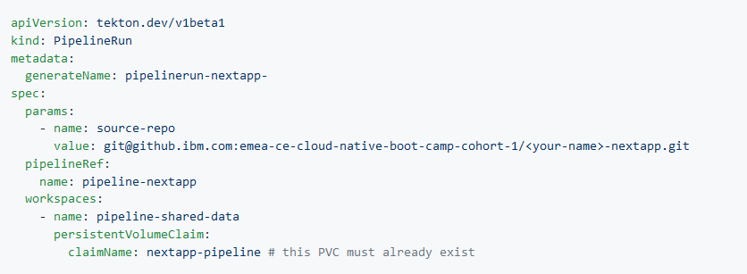
Pipeline & PipelineRun
You can use a Volume Claim Template or use an existing Persistent Volume Claim

Slide 19
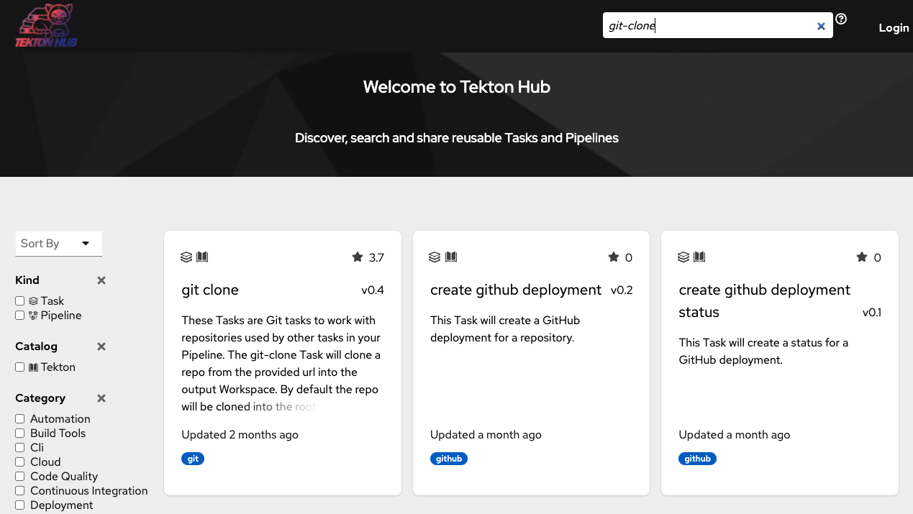

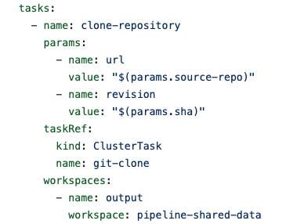
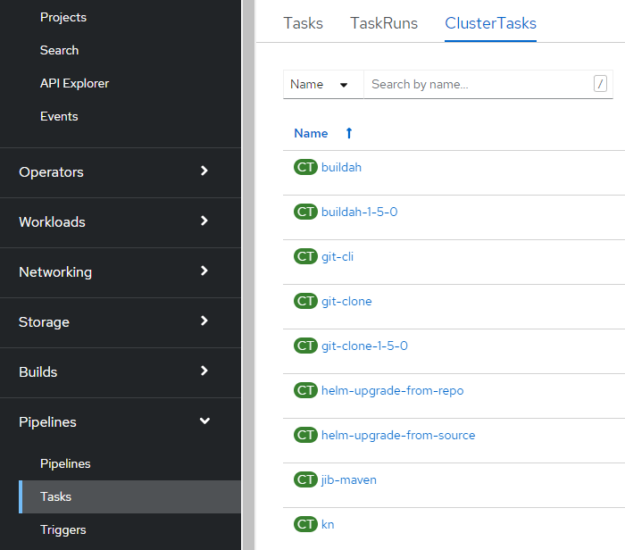
Task#1 clone
Tekton Catalog
REPO
SSH
Clone
Workspace

Slide 20
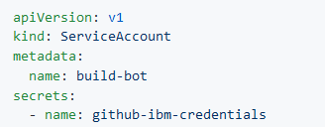
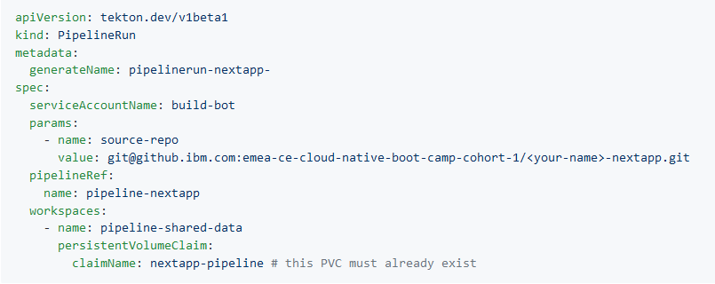
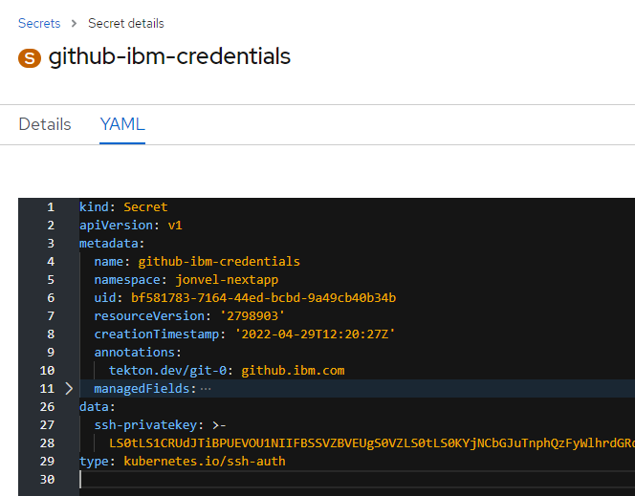
GitHub Enterprise authentication
Service
Account
PipelineRun
Secret

Slide 21
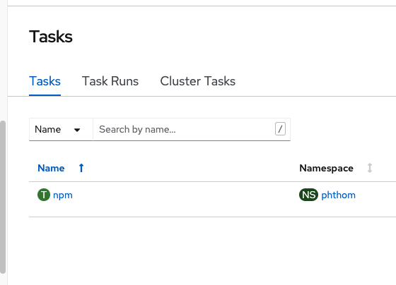
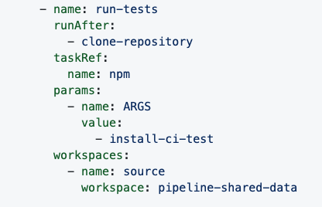

Task#2 CI Tests
RunTests
Workspace

Slide 22
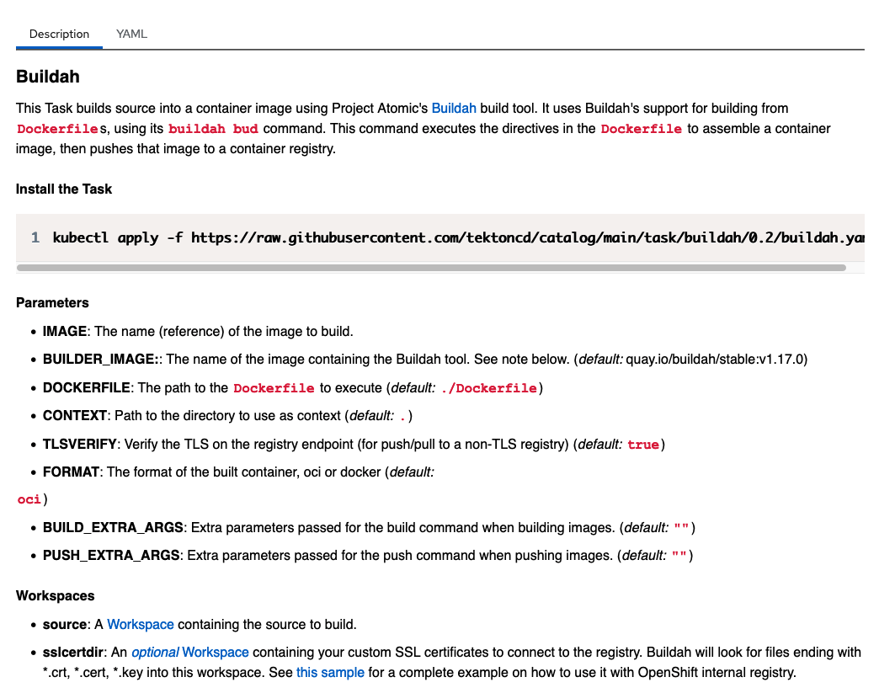
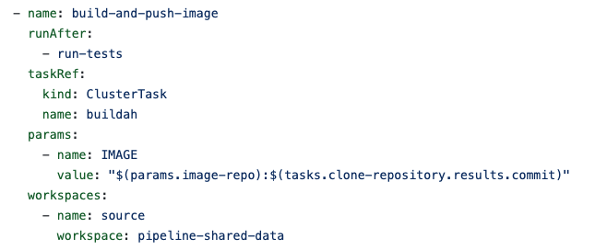
Task#3 Build & Push
Build-Push
Workspace
Buidah has 3 steps

Slide 23
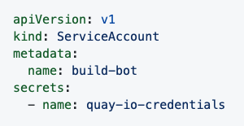
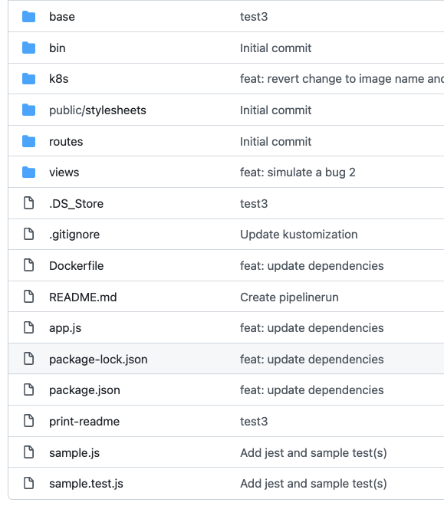
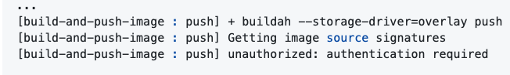
Build & Push
App
Code
Image
Registry
Container
Image
Libs Bins
Config
Push
Buildah
Security access to Registry
(for example quay.io)
./Dockerfile

Slide 24
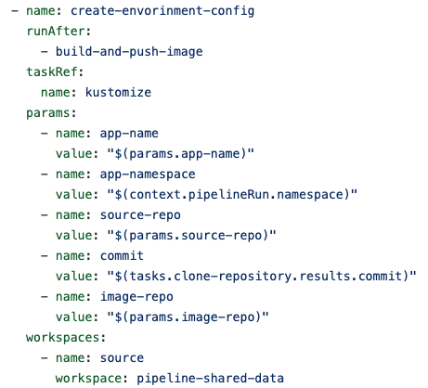
Task#4 Manifests
Project
Namespace
Configmap
Manifests
PV
Secrets
Services
PV Claims
Workspace
Routes
Ingresses
Deployment
Pod

Slide 25
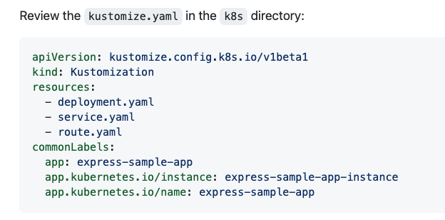
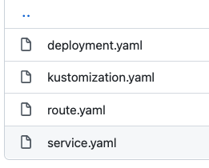
Kustomize
k8s Directory
1 file : manifest.yaml with all resources like sevices, deployment, routes, PVC …

Slide 26
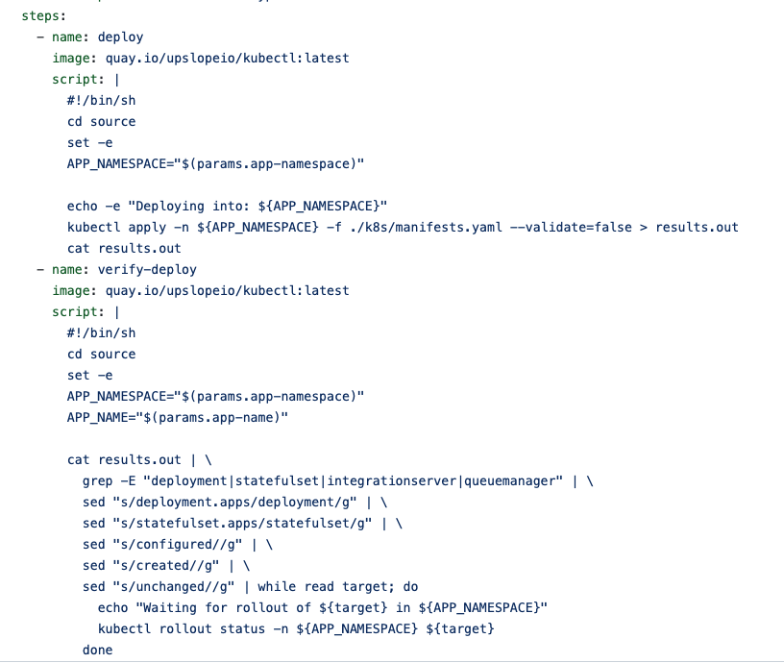
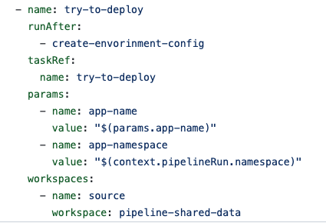
Task#5 Deploy (to dev)
Deploy
Workspace

Slide 27
Task#6 Tekton Triggers
Push
Repo
Security : token
Webhook
Tekton Trigger
To PipelineRun
Clone
RunTests
Build-Push
Manifests
Deploy
Workspace

Slide 28
We hope you’ll learn something useful out of this bootcamp
This is also an opportunity to get to know some of your peers
So Enjoy it !

